Slide 1
S.W.O.T. Analysis

Slide 2
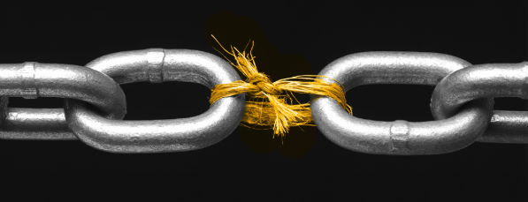
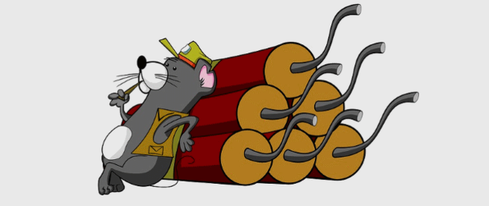
SWOT Analysis
SWOT stands for:
Strengths, Weaknesses, Opportunities, and Threats
https://www.taivara.com/finding-a-viable-market-opportunity/
https://www.tarshpartnership.co.uk/career-advice/interview-tips-whats-your-biggest-weakness/
https://www.forbes.com/sites/melodywilding/2019/09/09/the-quiet-strength-of-the-ambitious--introvert/#7940fc8b7736
https://www.zdnet.com/article/bomb-threat-scammers-are-now-threatening-to-throw-acid-on-victims/

Slide 3
SWOT Analysis
SWOT stands for:
Strengths, Weaknesses, Opportunities, and Threats
Who should do a SWOT analysis?
Administration
https://bmismartcloud.com/system-administration/
Notes:
For a SWOT analysis to be effective, company founders and leaders need to be deeply involved. This isn’t a task that can be delegated to others.

Slide 4
SWOT Analysis
SWOT stands for:
Strengths, Weaknesses, Opportunities, and Threats
Who should do a SWOT analysis?
Administration
Select people who can represent different aspects of your company, everyone should have a seat at the table.
https://bmismartcloud.com/system-administration/
Notes:
You need accurate input from people who are interacting daily with the organization.
This can be part of the strategic planning process as well.

Slide 5
SWOT Analysis
Strengths
Strengths are internal, positive attributes of your company. These are things that are within your control.

Slide 6
SWOT Analysis
Strengths
Strengths are internal, positive attributes of your company. These are things that are within your control.
What’s successful?
What assets (Soft)?
What physical assets (Hard)?
What competitive advantages do you have over your competition?
Notes:
What business processes are successful?
What assets do you have in your team, such as knowledge, education, network, skills, and reputation?
What physical assets do you have, such as customers, equipment, technology, cash, and patents?
What competitive advantages do you have over your competition?

Slide 7
SWOT Analysis
Weaknesses
Weaknesses are negative factors that detract from your strengths. These are things that you might need to improve on to be competitive.

Slide 8
SWOT Analysis
Weaknesses
Weaknesses are negative factors that detract from your strengths. These are things that you might need to improve on to be competitive.
NEEDs?
Process improvement?
Tangible assets?
Gaps in team/Programming?
Is your location ideal for your success?
Notes:
Are there things that your business needs to be competitive?
What business processes need improvement?
Are there tangible assets that your company needs, such as money or equipment?
Are there gaps on your team?
Is your location ideal for your success?

Slide 9
SWOT Analysis
Opportunities
Opportunities are external factors in your business environment that are likely to contribute to your success.

Slide 10
SWOT Analysis
Opportunities
Opportunities are external factors in your business environment that are likely to contribute to your success.
Market Growth/Trends?
Upcoming events to take advantage?
Upcoming changes that might impact your company positively?
What do customers think of you?
Notes:
Is your market growing and are there trends that will encourage people to buy more of what you are selling?
Are there upcoming events that your company may be able to take advantage of to grow the business?
Are there upcoming changes to regulations that might impact your company positively?
If your business is up and running, do customers think highly of you?

Slide 11
SWOT Analysis
Threats
Threats are external factors that you have no control over. You may want to consider putting in place contingency plans for dealing them if they occur.

Slide 12
SWOT Analysis
Threats
Threats are external factors that you have no control over. You may want to consider putting in place contingency plans for dealing them if they occur.
Competitors?
Suppliers/raw materials?
Changes in technology?
Consumer behavior change?
Are there market trends that could become a threat?
Notes:
Do you have potential competitors who may enter your market?
Will suppliers always be able to supply the raw materials you need at the prices you need?
Could future developments in technology change how you do business?
Is consumer behavior changing in a way that could negatively impact your business?
Are there market trends that could become a threat?

Slide 13
SWOT Analysis
Like ‘Brainstorming’ SWOT can be done correctly and incorrectly.
AVOID GROUP THINK!
Notes:
May choose to present the prompting questions to individuals first then compile a list of input.

Slide 14
SWOT Analysis: Example

Slide 15
SWOT Analysis: Example
https://www.liveplan.com/blog/what-is-a-swot-analysis-and-how-to-do-it-right-with-examples/

Slide 16
SWOT Analysis
With a new partner:
Develop a SWOT analysis for the Outdoor Program
Come up with at least three items for each letter

Slide 18
SWOT Analysis
From SWOT analysis to strategies
Strengths–Opportunities. Use your internal strengths to take advantage of opportunities.

Slide 19
SWOT Analysis
From SWOT analysis to strategies
Strengths–Opportunities. Use your internal strengths to take advantage of opportunities.
Strengths-Threats. Use your strengths to minimize threats.

Slide 20
SWOT Analysis
From SWOT analysis to strategies
Strengths–Opportunities. Use your internal strengths to take advantage of opportunities.
Strengths-Threats. Use your strengths to minimize threats.
Weaknesses-Opportunities. Improve weaknesses by taking advantage of opportunities.

Slide 21
SWOT Analysis
From SWOT analysis to strategies
Strengths–Opportunities. Use your internal strengths to take advantage of opportunities.
Strengths-Threats. Use your strengths to minimize threats.
Weaknesses-Opportunities. Improve weaknesses by taking advantage of opportunities.
Weaknesses-Threats.
Notes:
Threats are things you cannot control, but you can be proactive about.

